Slide 1
Trading Bot (Stop Loss)ing money
Antonio Garza, Mike Hobbs, Ezra Hsiao

Slide 2
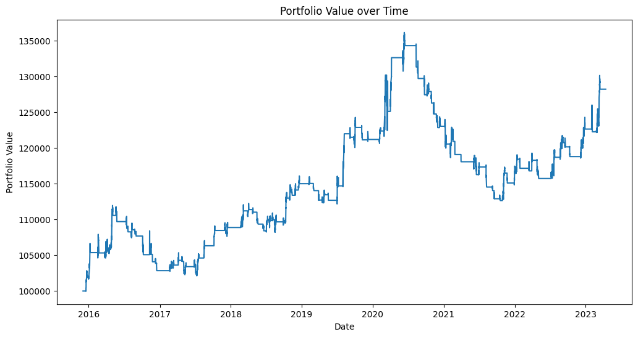

Slide 3
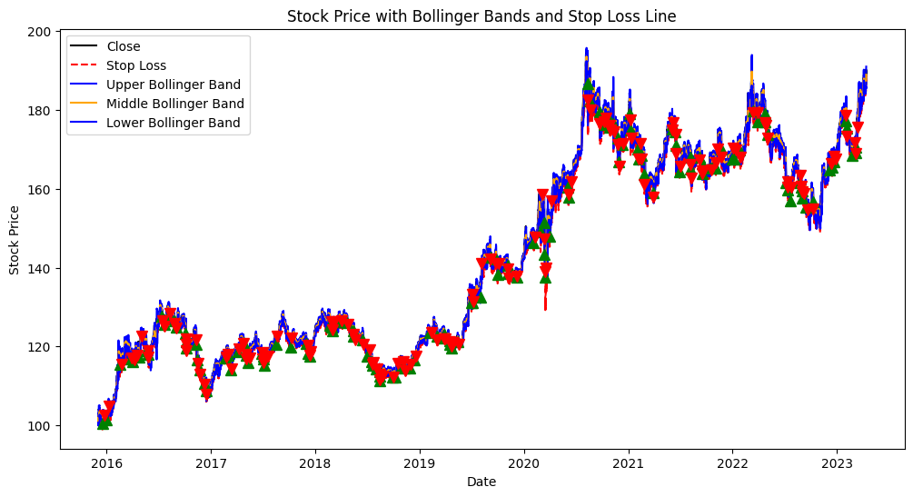
Trades!

Slide 4
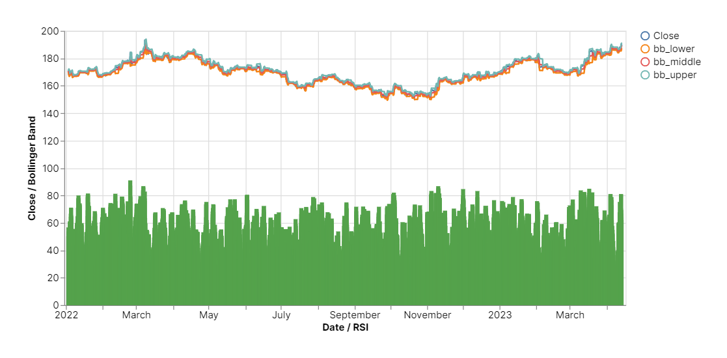
GOLD Graph!

Slide 5
Pandas, Numpy
Finta, Sklearn
Alpaca_trade_api
IPython
Trading Parameters in Data
ATR(Average True Range)
Portfolio Value
Portfolio Profit
Total Returns
Annualized Returns
Trade Win Rate
Imports & API
Data Cleaning
Trading Signals
Machine Learning Results
Trading Results
Logistic Regression Model
Random Forest Model
Precision
Recall
F1-score
Support
Accuracy
Macro Avg
Weighted Avg
Def (get_stock_data)
Matching to Finta library Parameters
Bollinger Bands
RSI

Slide 6

Executive Summary
This project aims to develop a trading strategy that uses technical analysis and risk management to identify potentially undervalued stocks and generate buy signals.
The strategy employs Bollinger Bands and Relative Strength Index (RSI) as indicators to generate buy signals and Average True Range (ATR) to set a trailing stop loss. The objective is to evaluate the effectiveness of the trading strategy and to identify potential improvements with Machine Learning Models
Notes:
This project aims to develop a trading strategy that uses technical analysis and risk management to identify potentially undervalued stocks and generate buy signals.
The strategy employs Bollinger Bands and Relative Strength Index (RSI) as indicators to generate buy signals and Average True Range (ATR) to set a trailing stop loss. The objective is to evaluate the effectiveness of the trading strategy and to identify potential improvements with Machine Learning Models

Slide 7

Trading Bot, Fintech, and Machine Learning.
This project relates to fintech and machine learning by leveraging technical analysis to develop a trading strategy and using machine learning algorithms to evaluate its effectiveness.
The project uses Python programming language and several libraries to collect and analyze data and train models.
The project uses two machine learning models, namely Logistic Regression and Random Forest, to evaluate the trading Strategy's effectiveness. In the context of this project, using both models allows for a comparison of their performance and can provide insights into the strengths and weaknesses of each model.
Notes:
This project relates to fintech and machine learning by leveraging technical analysis to develop a trading strategy and using machine learning algorithms to evaluate its effectiveness.
The project uses Python programming language and several libraries to collect and analyze data and train models.
The project uses two machine learning models, namely Logistic Regression and Random Forest, to evaluate the trading Strategy's effectiveness. In the context of this project, using both models allows for a comparison of their performance and can provide insights into the strengths and weaknesses of each model.

Slide 8

Data Preparation
The source of data for this project is the Alpaca API, which provides historical stock data for the specified ticker. We chose this data source because it is reliable and provides up-to-date data that can be used for trading purposes.
Next, the necessary technical indicators (Bollinger Bands, RSI, and ATR) were calculated using the Finta library. These indicators were used to generate buy signals and set the trailing stop loss as part of the trading strategy.
Finally, the data was split into training and testing sets using the train_test_split function from scikit-learn. The training set was used to fit the machine learning models (Logistic Regression and Random Forest), while the testing set was used to evaluate the performance of the models.
Notes:
The source of data for this project is the Alpaca API, which provides historical stock data for the specified ticker. We chose this data source because it is reliable and provides up-to-date data that can be used for trading purposes.
Next, the necessary technical indicators (Bollinger Bands, RSI, and ATR) were calculated using the Finta library. These indicators were used to generate buy signals and set the trailing stop loss as part of the trading strategy.
Finally, the data was split into training and testing sets using the train_test_split function from scikit-learn. The training set was used to fit the machine learning models (Logistic Regression and Random Forest), while the testing set was used to evaluate the performance of the models.

Slide 9
DEMO!
The approach that your group took to achieve the project goals.
Include any relevant code or demonstrations of the machine learning model.
Describe the techniques that you used to evaluate the performance of the model.
Discuss any unanticipated insights or problems that arose and how you resolved them.

Slide 10
Result & Conclusion
Team Goal:
To create a Trading bot and measure results… Half win, created analysis on stock trading strategies.

Slide 11
Whats next for Trading Bot
?
Antonio
Ezra
Mike

